Slide 1

Music Recommendation System through facial expression Using CNN
ADITYA ENGINEERING COLLEGE(A)
Batch No : B2
Under the Guidance of
Dr .P. UdayaKumar
Professor
Department of CSE
Aditya Engineering College (A)
Presented By
1.Ch.Govind (19A91A0575)
2.S.V.V.Satyanarayana (19A91A05B6)
3.Sk.Amreen (19A91A05C1)

Slide 2
Contents
Abstract
Introduction
1.1 Problem Statement
1.2 Aim & Objective of Project
1.3 Existing system
1.4 Proposed system and Advantages
1.5 Literature Survey Comparison Table
2.Requirement Analysis (SRS/HRS)
3.Architecture
4.Project Flow

Slide 3
ABSTRACT
Emotion is based on human feelings which can be both expressed or not. Emotion expresses the human’s individual behavior which can be in different forms. Extraction of the emotion states humans individual state of behavior.
The objective of this project is to extract feature from human face and detect emotion and to play music according to the emotion detected.
Some steps like face detection using webcam, facial landmark extraction, facial expression detection, with that connecting to a music player are going to be followed.

Slide 4
INTRODUCTION
Music listeners have a tough time creating and segregating the playlist manually when they have hundreds of songs.
It is also difficult to keep track of all the songs: sometimes songs that are added and never used, wasting a lot of device memory, and forcing the user to find and delete songs manually.
Users must manually select songs every time based on interest and mood. User’s also have difficulty to reorganize and playing music when play-style varies. Machine Learning concept which involves facial scanning and feature tracking to determine the user’s mood and based on it gives a personalized playlist.

Slide 5
AIM & OBJECTIVE
Aim: To implement a Music system that recommends songs based on the facial expression.
Objective: Haar Cascade is a machine learning algorithm to categorize objects in a captured image. It is used for object detection. The cascade classifier has different stages of collection which resembles from weak learners. These weak classifiers are the simplest form classifiers that have a name called boosting. If the label ranges in positive state, then it goes to the next stage showing the result.

Slide 6
LITERATURE SURVEY
S.No | Reference Paper Title | Purpose | Drawbacks
1 | Shalini, Shantha K., et al. "Facial Emotion Based Music Recommendation System using computer vision and machine learning techniques." Turkish Journal of Computer and Mathematics Education 12.2 (2021): 912-917. | They used for extracting the facial features from the original facial input images and also they proposed to extract region of interest from the input facial images. | Presence of middle man for verification of land.
2 | Real Time Emotion Based Music Player Using CNN Architectures.International Conference for Convergence in Technology (I2CT) Pune, India. | The main concepts used here are data preparation which is nothing but dataset, data augmentation, class weighting, ensembling. | More emphasizes on smart contract rather than implementation.

Slide 7
EXISTING SYSTEMS:
In previous papers they got high accuracy for all facial expressions except anger and neutral. Because it is difficult to distinguish between anger and neutral for the model while training the image dataset.
If we consider the already proposed systems, they are showing around 29% accuracy for anger and neutral expressions. The most used dataset is FER2013. The algorithm is CNN (Convolution Neural Network) only for the training of facial image dataset but the problem is while training the dataset the model is unable to identify which is anger .

Slide 8
DISADVANTAGES:
1. Not recommend any more based on recognisation.
2. Does Not contain any Face recognisation Module.
3. The main limitation of this paper is it does not explore other multi-class SVM formulations.

Slide 9
BLOCKCHAIN:
CNN (Convolutional Neural Network) is a deep learning architecture that has been very successful in processing and analyzing visual data such as images and videos. The architecture of a CNN consists of several layers that perform different tasks, such as convolution, pooling, and fully connected layers.
Convolutional layers: These layers perform the convolution operation, which involves applying a set of filters to the input image to extract relevant features. The output of each filter is a feature map that highlights different aspects of the input image.

Slide 10
Activation function: After the convolutional layer, the activation function is applied to introduce non-linearity into the system. A common activation function is the Rectified Linear Unit (ReLU), which replaces negative values with zero.
Pooling layers: Pooling layers are used to reduce the spatial dimensions of the feature maps, which helps to reduce the number of parameters in the model and prevent overfitting. Common pooling techniques include max pooling and average pooling.
Fully connected layers: These layers connect all the neurons in one layer to every neuron in the next layer. These are similar to traditional neural networks.
Softmax layer: This is typically the last layer in a CNN, and it is used to classify the input image into one of several classes. The softmax function takes the output from the previous layer and normalizes it to produce a probability distribution over the classes.

Slide 11
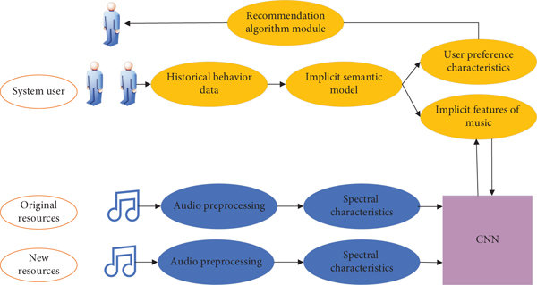
CNN ARCHITECTURE:

Slide 12
PROPOSED SYSTEM:
There are seven emotions that a human being can express on their face they are anger, disgust, fear, happy, sad, surprise. This project is working on detection of facial expression of a person and based on that respective music will be played.

Slide 13
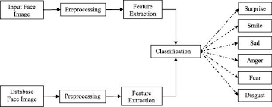
PROPOSED SYSTEM:

Slide 14
ADVANTAGES:
Improved personalization: By analyzing a user's facial expression, the system can make more accurate predictions about their emotional state and recommend music that is better suited to their current mood.
Convenience: The system is designed to be easy to use, with no need for users to input any data or make any explicit requests. All they need to do is express their emotions, and the system will do the rest.
Enhanced user experience: By providing personalized music recommendations that are aligned with the user's emotional state .

Slide 15
System Requirements
Hardware Requirements:
Processor: Minimum 1.5GHz; Recommended 2GHz or more.
Ethernet Connection (LAN or Wi-Fi).
Hard Drive: Minimum 50GB; Recommended 100GB or more.
Memory (RAM): Minimum 4GB; Recommended 8GB or above.
A web cam with high resolution ,frame rate,field of view ,AutoFocus .

Slide 16
Software Requirements:
Operating Systems recommended: Windows 10 or Linux: Ubuntu.
Microsoft Visual Studio Code.
Python software includes random, PYgame etc modules.
A web browser such as Chrome or Firefox.
A set of songs and emotions in order to train the data set.

Slide 17
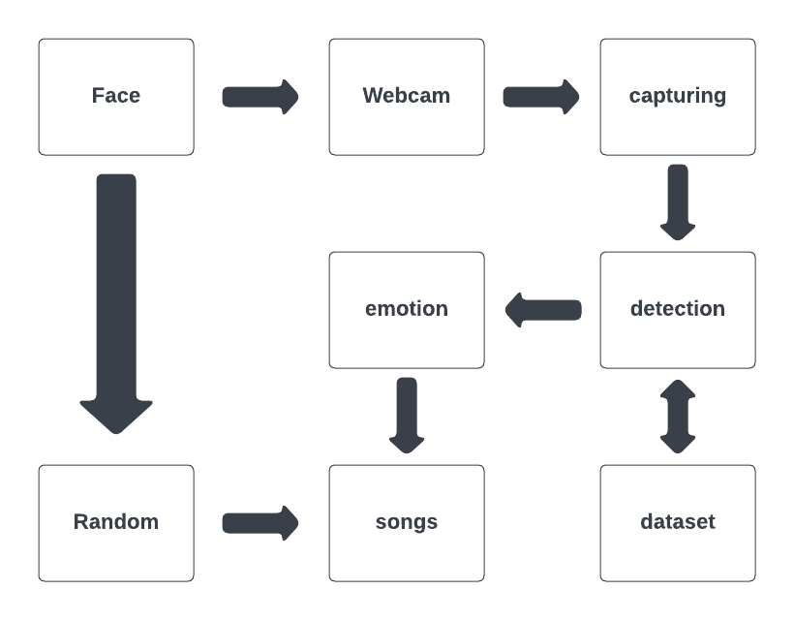
Sequence Diagram:
UML Diagrams:

Slide 18
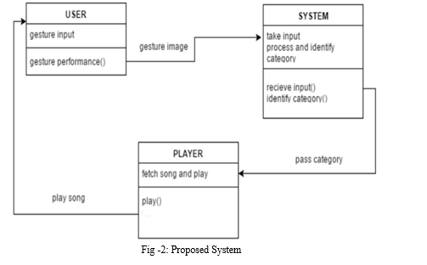
Component Diagram:
UML Diagrams:

Slide 19
IMPLEMENTATION:
Facial detection and tracking: Use a facial detection and tracking algorithm to detect and track faces in the video stream. This can be done using a library such as OpenCV or Dlib.
Emotion detection: Use the trained CNN model to classify the emotions displayed on each detected face in real-time. This involves passing each detected face through the CNN and obtaining the emotion probabilities from the output softmax layer.
Display results: Display the emotion classification results in real-time, such as by drawing boxes around each detected face and displaying the corresponding emotion label.

Slide 20
Project Flow
Data preprocessing: Preprocess the collected data by applying image processing techniques such as cropping, resizing, and normalization to the facial expression images. This helps to standardize the input data and reduce noise in the images.
Data augmentation: Use data augmentation techniques such as flipping, rotation, and zooming to create additional variations of the training data. This helps to increase the diversity of the dataset and improve the robustness of the model.

Slide 21
Project Flow
Split the dataset: Split the dataset into training, validation, and testing sets. The training set is used to train the CNN model, the validation set is used to tune the model's hyperparameters, and the testing set is used to evaluate the model's performance.
Define the CNN architecture: Define the architecture of the CNN model. The architecture should consist of multiple convolutional layers, pooling layers, and fully connected layers. The output of the CNN should be a softmax probability distribution over the different emotional categories

Slide 22
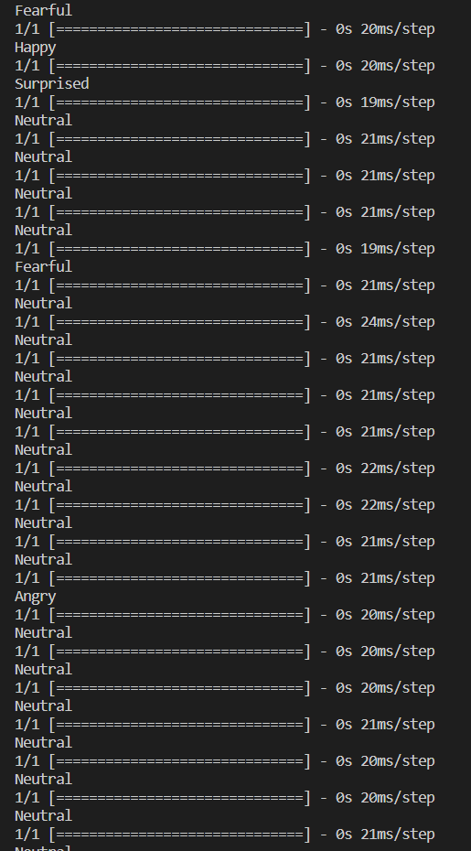
Splash Screen

Slide 23
OUTPUT
If a music recommendation system uses facial expressions to recommend music, it may display the following information on the output screen:
The user's current facial expression (e.g. happy, sad, angry, etc.).
The recommended music genre or song that matches the user's current facial expression.
Additional options for the user to explore other songs or genres that match their current mood or preferences.

Slide 24
CONCLUSION
Emotions are one of the fascinating features of the human mind. Music is an equally extraordinary characteristic. Understanding the special interaction between the two may take us closer to understanding the fundamental nature of both. A simple system is proposed here for the music recommendation using face emotion recognition. It suggests music by extracting different facial emotions of a person: Happy, anger, sad, neutral, fear and surprise.

Slide 25
FUTURE SCOPE
Apart from recommending the music depending on the Facial expression these algorithms may be extended such that they divert the present sad, angry mood to an usual mood.

Slide 26

Table for student contribution
Sno | 19A91A0575 | 19A91A05B9 | 19A91A05C1
Literature Survey
Problem Formulation
Requirements gathering
Resource Estimation
Documentation
PPT Preparation

Slide 27
References
1. Ali Moradi Afrapoli & Hooman Askari-Nasab, Mining fleet management systems: a review of models and algorithms, 2017.
2. Reza malekian, Ntefeng ruth Moloisane, Lakshmi Nair, B.T.Maharaj,, Design and implementation of a wireless OBD || Fleet Management System, 2016.
3. Jinhu Lu, Identifying key factors for introducing GPS-based Fleet Management Systems to the Logistics Industry, 2015.
4. Stephen Teang Soo Thong, Tharek Abdul Rahman, Intelligent Fleet Management System with Concurrent GPS & GSM Real-Time Positioning Technology, 2007.
5. Holger Billhardt, Alberto Fernandez, Marin Luzak, Carles Sierra, Dynamic Coordination in Fleet Management Systems: Towards Smart Cyber Fleets, 2014.

